Slide 1
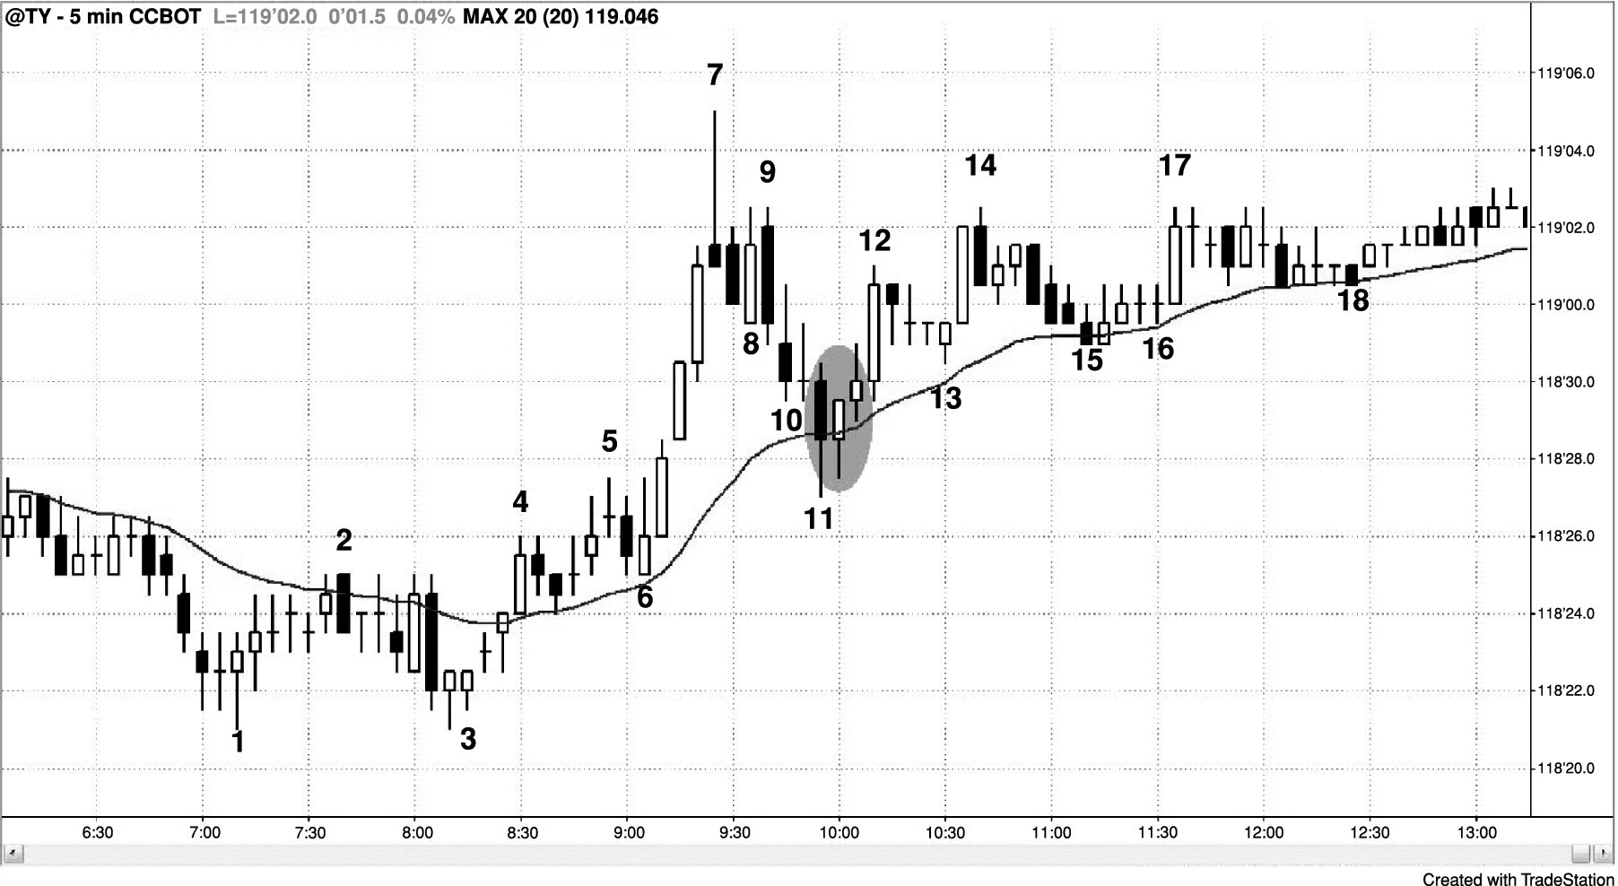
FIGURE 30.1 Pullbacks End at a Confluence of Support Types

Slide 2
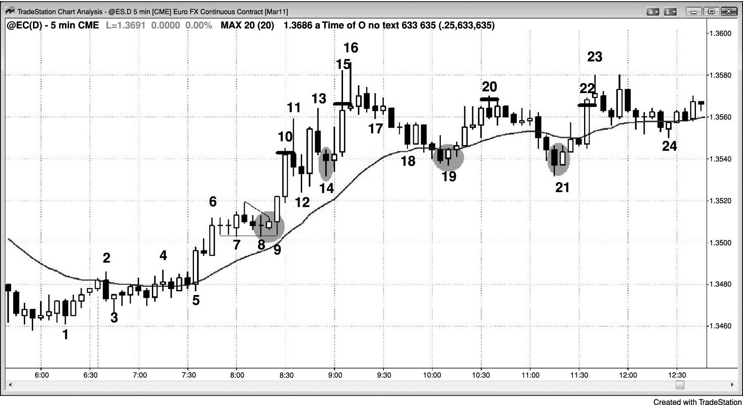
FIGURE 30.2 Buying Pullbacks in a Bull Trend

